Slide 1
HOW IT WORKS IN A SD-IRA
Presented by
CARRIE COOK

Slide 2
STEP
1
Determine IRA Type
Complete application online
STEP
2
Fund your account
STEP
3
Identify Investment and complete documentation
STEP
4
Notes:
Welcome
Introduction to Preferred Trust Company

Slide 3
STEP
1
Determine IRA Type
Complete application online
STEP
2
Fund your account
STEP
3
Identify Investment and complete documentation
Work with Ignite to create an Ignite account & Select Investment
Notes:
Welcome
Introduction to Preferred Trust Company

Slide 4
STEP
1
Determine IRA Type
Complete application online
STEP
2
Fund your account
STEP
3
Identify Investment and complete documentation
Sign Investment documents
Notes:
Welcome
Introduction to Preferred Trust Company

Slide 5
STREAMLINED PROCESS
Mortgage Broker Debt Representation Acknowledgement
Investment Authorization and Direction form
Investment documentation to secure your collateralized investment
Funds sent
Notes:
Ignite Funding completes the Mortgage Broker Debt Representation Acknowledgement for all investors prior to the funding of the Trust Deed and provides all necessary supporting documentation to Preferred Trust Company.
Ignite Funding has custom programmed the Investment Authorization and Direction form for Preferred Trust Company into your Ignite Funding investment documentation making the process to invest in Trust Deeds seamless.
Funds are moved from Preferred Trust Company to Ignite Funding prior to funding deadline from your authorization.
Ignite Funding provides all investment documentation to secure your collateralized investment to Preferred Trust Company after the funding of the investment is completed.

Slide 6
STEP
1
Determine IRA Type
Complete application online
STEP
2
Fund your account
STEP
3
Identify Investment and complete documentation
STEP
4
Receive investment income tax-free or tax-sheltered
Notes:
Welcome
Introduction to Preferred Trust Company

Slide 7
Loan pays off – IRA receives funds
You can reinvest with Ignite or diversify into other alternatives –
you’re in control!

Slide 8
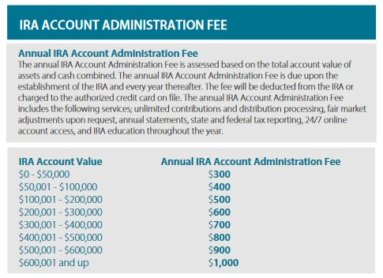
FEES
MININUM BALANCE REQUIREMENTS $500
View the complete Fee Schedule on the Preferred Trust website.

Slide 9
WHAT DO FEES INCLUDE?
ADMINISTRATION FEE
Annual tax documents and IRS reporting Ongoing review of PM under custody at depositories Processing of contributions and distributions Online account portal Annual processing of depository fee Annual statement packages / Monthly statement packages Phone and email support Continuing education
MINIMUM BALANCE
Keeps your account open and in good standing and is used to pay any account termination fees or transaction fees related to the transfer of your assets.

Slide 10
IS IT WORTH IT?
Funds Transferred to SDIRA
SDIRA Account Administration Fee
SDIRA Minimum Account Balance Requirement
Trust Deed Investment Transaction Fee
Available Amount to Invest at Ignite Funding
Annualized Income Generated
from Ignite Funding Investment
$40,000.00
$300.00 annually or $25.00 a month
$500.00
$20.00 per income transaction
$39,180.00
$3,918.00

Slide 11
This presentation is for general information and does not represent tax, legal and/or investment advice. Account usage, selection of investments and the performance of those investments are the sole responsibility of the investor and not Preferred Trust Company. Preferred Trust Company does not perform due diligence on any investment selected by an investor held in their Self-Directed IRA. Therefore, Preferred Trust Company strongly recommends that the investor seek professional advice from appropriate legal, accounting and/or tax professionals of their own choosing prior to making investments.
Preferred Trust Company, LLC | Financial Institutions Division of Nevada License #TR10025 6700 Via Austi Parkway, Suite 301, Las Vegas, NV 89119 | P: 888.990.7892

