Slide 1
CURRENT MARKET INSIGHTS
Presented by
PAT VASSAR

Slide 2
LOAN OWN
“
“
TO

Slide 3
VALUATION
Broker Price Opinion (BPO)
The estimated value of a property determined by a real estate broker, who is familiar with the local market, and bases the estimate on the characteristics of the property.

Slide 4
VALUATION
Comparable Market Price(CMP)
An estimate of a property’s price based on evaluating recently sold, similar properties in the immediate area based on a numbers of factors such as: location, size, and condition.

Slide 5
VALUATION
Independent Appraisal
A professional, impartial third-party valuation of real property to ensure fairness and accuracy. The evaluator will be qualified as an appraiser and study real estate values on a day-to-day basis.
Notes:
Investors can refer to the blog article Valuation Methodologies: Evaluating an Asset Our Way on our website for more information
https://blog.ignitefunding.com/valuation-methodologies-evaluating-an-asset-our-way

Slide 6
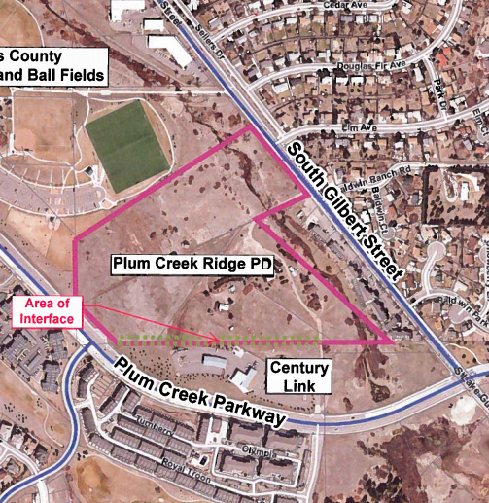
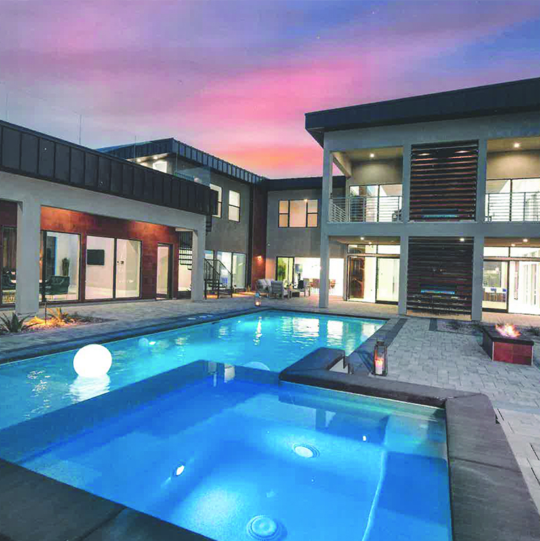
MACRO & MICRO MARKETS
Acquisition
Development
Construction
Residential
Commercial

Slide 7
BORROWERS

Slide 8
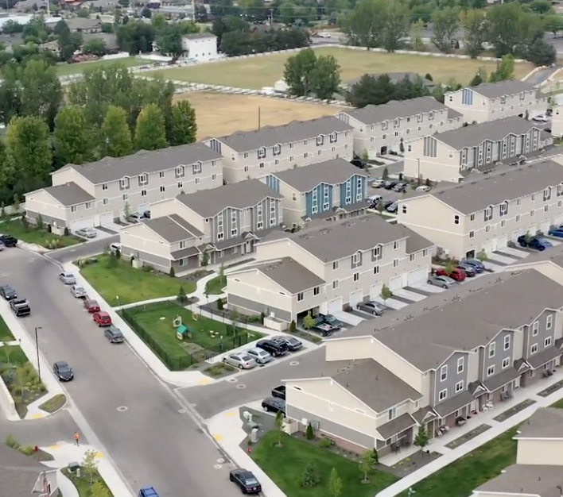
MARKET TRENDS
What Types of Real Estate are we expanding to?
All loans have already funded and are for demonstrative purposes only.

Slide 9
DISCLAIMER
As with all types of investments there are inherent risks when investing in Trust Deeds. Money invested through a mortgage broker is not guaranteed to earn any interest or return and is not insured. Before investing, investors will be provided applicable disclosures. Past performance does not guarantee future results or success. Ignite Funding requires a $10,000 minimum investment. The Nevada Mortgage Lending Division requires that investors meet a minimum suitability standards to ensure that the investor’s financial and investment goals warrant the risk of the investment.
Ignite Funding, LLC | 6700 Via Austi Parkway, Suite 300, Las Vegas, NV 89119 | P 702.739.9053 | T 877.739.9094 | F 702.922.6700 | NVMBL #311 | AZ CMB-0932150 |

