Slide 1
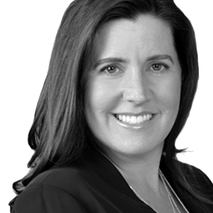
THIS IS HOW WE DO IT
Presented by
CARRIE COOK

Slide 2
IGNITE FUNDING OVERVIEW
Regulated/Licensed Mortgage Broker
Offering Trust Deed Investments since 2011
Annualized Returns – 10% to 12%
Short-term Investment
Transparency with minimal loss
Full Internal Operations

Slide 3
A - Z
Originate
Service
Fund
Defaults

Slide 4
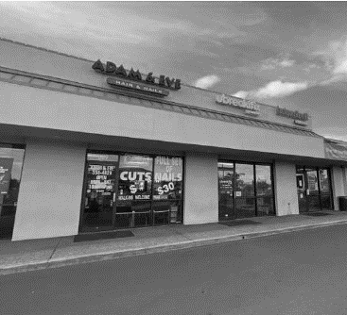
WHAT IS A TRUST DEED INVESTMENT?
A Trust Deed Investment is when a lender (you) lends money to a borrower (homebuilder/developer) that is secured by real estate.

Slide 5
WHAT IS A TRUST DEED INVESTMENT?
A Trust Deed Investment is when a lender (you) lends money to a borrower (homebuilder/developer) that is secured by real estate.

Slide 6
WHAT MAKES
IGNITE FUNDING
DIFFERENT?

Slide 7
WHAT MAKES IGNITE FUNDING DIFFERENT?
Low Barrier to Entry – Minimum Investment $10,000
Geographic/Borrower Diversification – Mitigated Risk
Less Volatility – Collateralized Investment
Consistent Monthly Income – Passive Income
Deal Flow - Consistency

Slide 8
WHAT MAKES IGNITE FUNDING DIFFERENT?
Low Barrier to Entry – Minimum Investment $10,000
Geographic/Borrower Diversification – Mitigated Risk
Less Volatility – Collateralized Investment
Consistent Monthly Income – Passive Income
Deal Flow - Consistency

Slide 9
OCTOBER
NOVEMBER
DECEMBER
$24
$27
$28
MM FUNDED
MM FUNDED
MM FUNDED
12
22
25
LOANS
LOANS
LOANS

Slide 10
SERVICING
$339
MM AS OF 1.4.23
FUNDED
$1.4
BILLION SINCE 2011
LOANS
1,800
SINCE 2011
OVER

Slide 11
STEP ONE
OPEN AN ACCOUNT
STEP TWO
SELECT AN INVESTMENT
STEP THREE
COMPLETE LOAN
DOCS AND SEND FUNDS
STEP FOUR
LOAN IS
FUNDED
STEP SEVEN
LOAN IS REPAID
STEP SIX
COLLECT INTEREST
STEP FIVE
POST CLOSING DOCS

Slide 12
DISCLAIMER
As with all types of investments there are inherent risks when investing in Trust Deeds. Money invested through a mortgage broker is not guaranteed to earn any interest or return and is not insured. Before investing, investors will be provided applicable disclosures. Past performance does not guarantee future results or success. Ignite Funding requires a $10,000 minimum investment. The Nevada Mortgage Lending Division requires that investors meet a minimum suitability standards to ensure that the investor’s financial and investment goals warrant the risk of the investment.
Ignite Funding, LLC | 6700 Via Austi Parkway, Suite 300, Las Vegas, NV 89119 | P 702.739.9053 | T 877.739.9094 | F 702.922.6700 | NVMBL #311 | AZ CMB-0932150 |

